Slide 1


Marketing Analytics Hackathon Visualization and Analysis - Amrita Nair
Mentor – Molly DeJohn

Slide 2
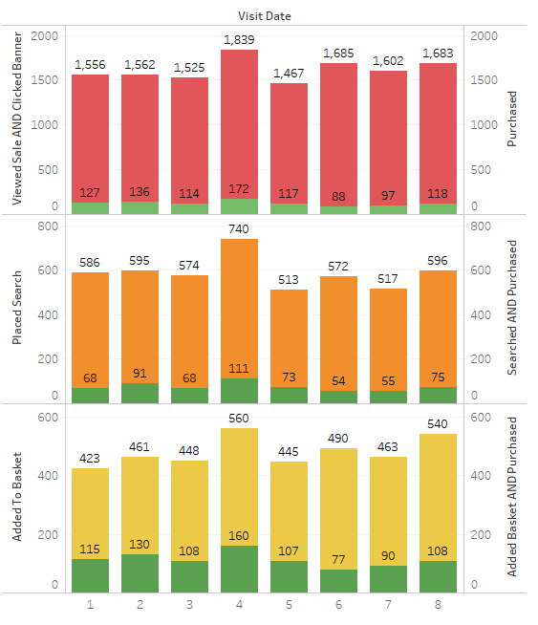
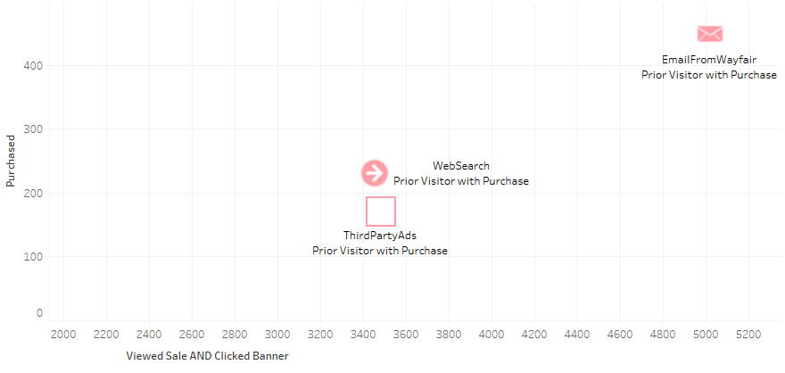
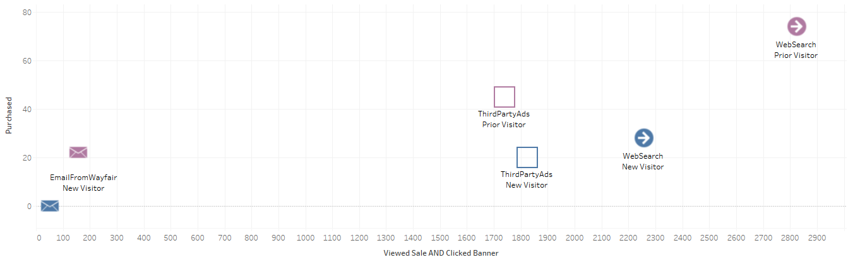
Are your banners effectively converting your users?
Measuring Campaign Performance of users who react to sales
What were the most effective ways of reaching your customers that led to conversions?
By looking into different visitor groups that reacted to the sale, we see that prior visitors with purchase (pink) are best reached by email – they are the ones who convert. This means that people who are likely to buy more subscribe to emails from Wayfair. For prior visitors(purple), it looks like emails aren’t as effective. This can be changed by positioning the email blasts specific to prior visitors. A/B testing should be performed on prior visitors in terms of discounts offered, layout of email, pictures in email and frequency of emails. Monitoring the response rate and conversions of targeted users will help you gauge the performance.
We see that current conversion rate of users who reacted to the sale (both viewed the sale and clicked the banner) is around 8%. The above bar charts show how users who showed interest in the sale engage with the website and how those engagements lead to purchases.

Slide 3
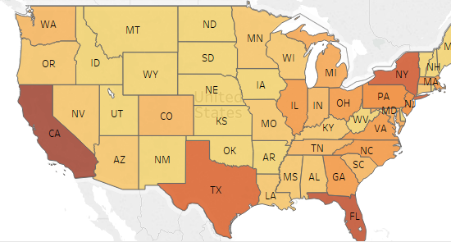
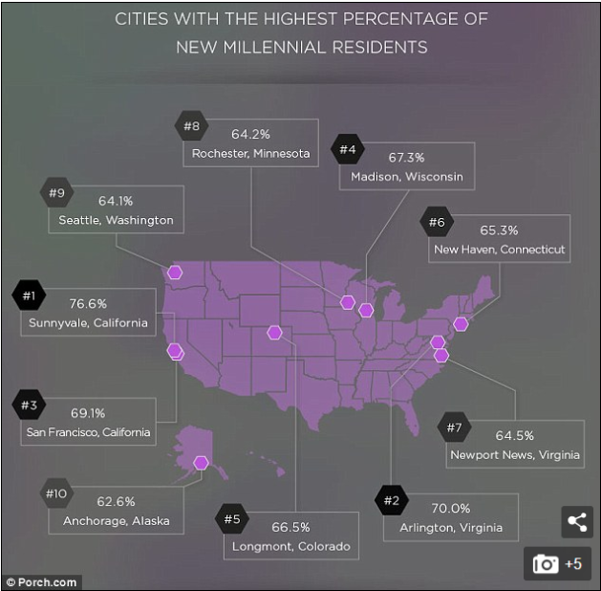
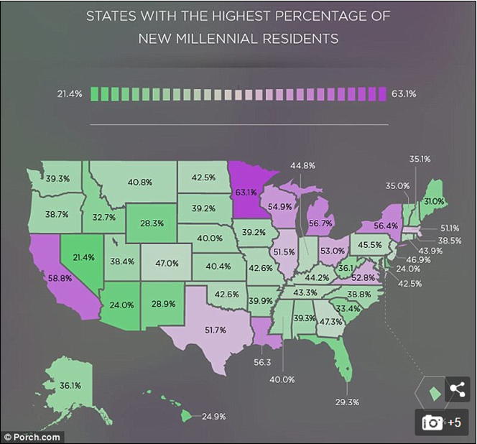
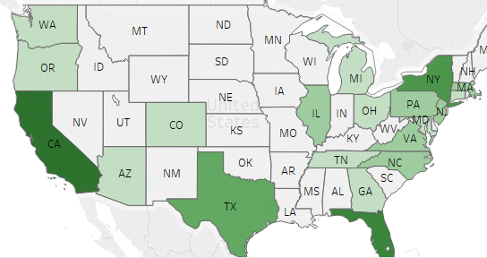
Exploring New Markets
The first heatmap shows the density of users who reacted to the sale by clicking banners for each region. The second shows heatmap of the density of users who converted out of all those who reacted. We see that CA, TX, FL and NY are the top performing states.
Recent external data shows us that MN, MI, and LA are some of the states with the highest percentage of new millennial residents. Since this would be your target customers, it would be best to identify regional micro trends and create customized banners that target those users. Considering the first map, it looks like we also need to find a way to raise awareness by performing marketing campaigns through influencers in those states.

Slide 4
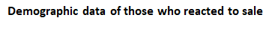
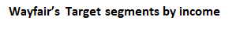
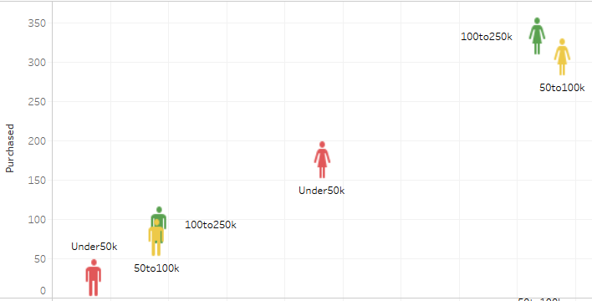
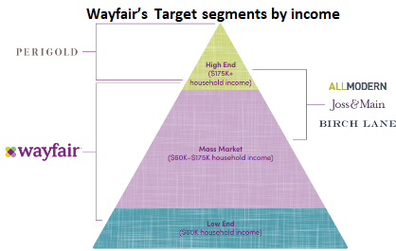
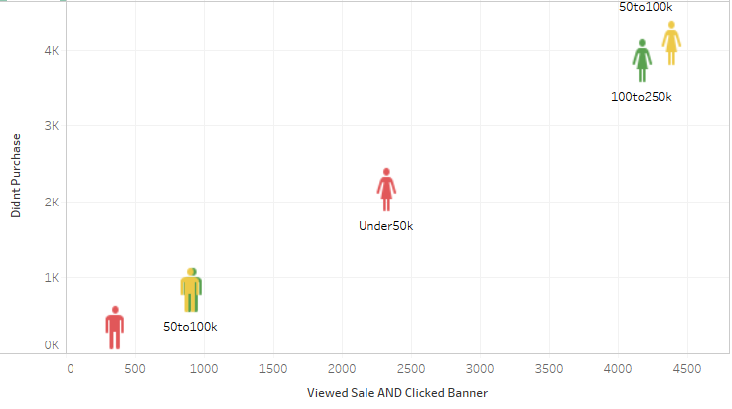
Understanding Barriers and Improving User Experience
The point of discounting prices is to attract and convert price sensitive customers. The above graphs show that women of 50-100k income bracket are reacting to the sale by clicking banners but most of them don’t convert. Wayfair’s target market comprises of 50-100k income range. We need more data to understand why they aren’t converting as much as 100-250k income women. It could be the items portrayed on the banner ads, discounts offered, etc. Customizing the experience for 50-100k women by carefully choosing items (based on discounted price and preference) that show up on the page after the banner is clicked could drastically change conversions.

Slide 5
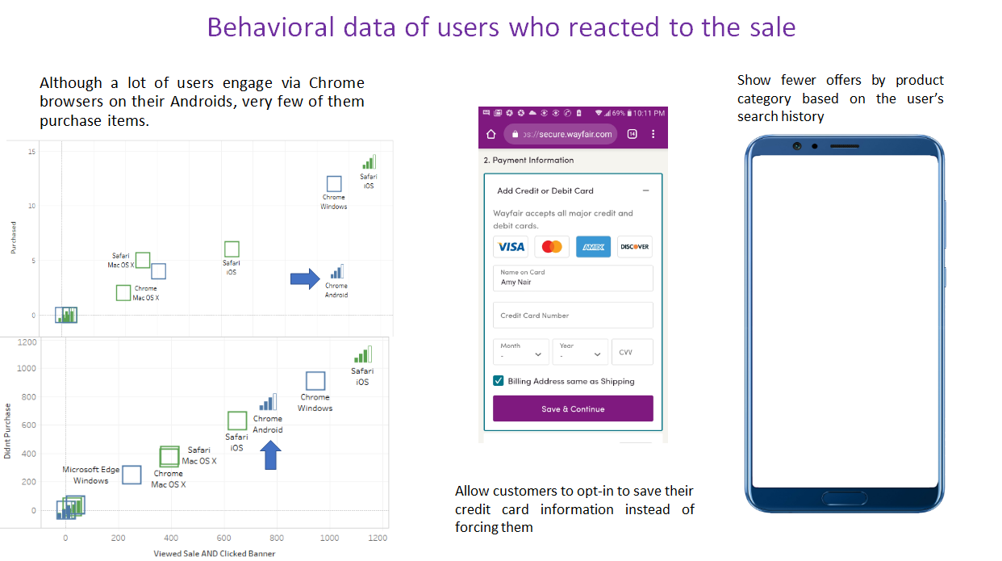
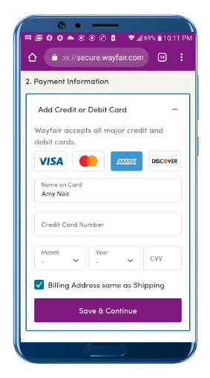
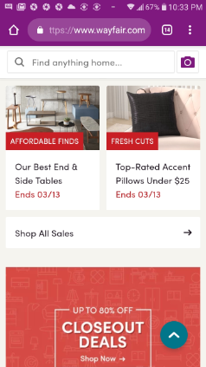

Slide 6
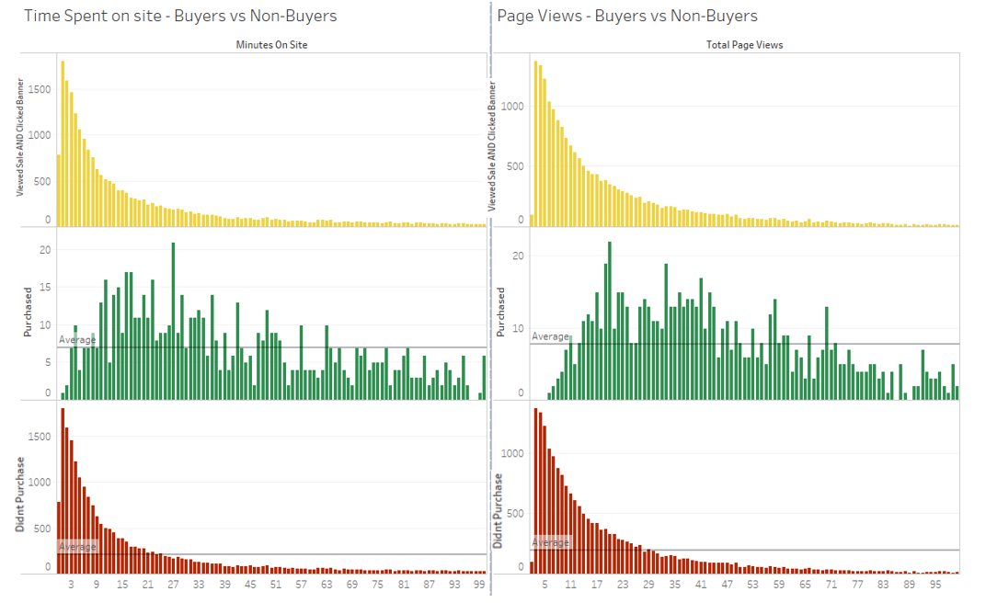

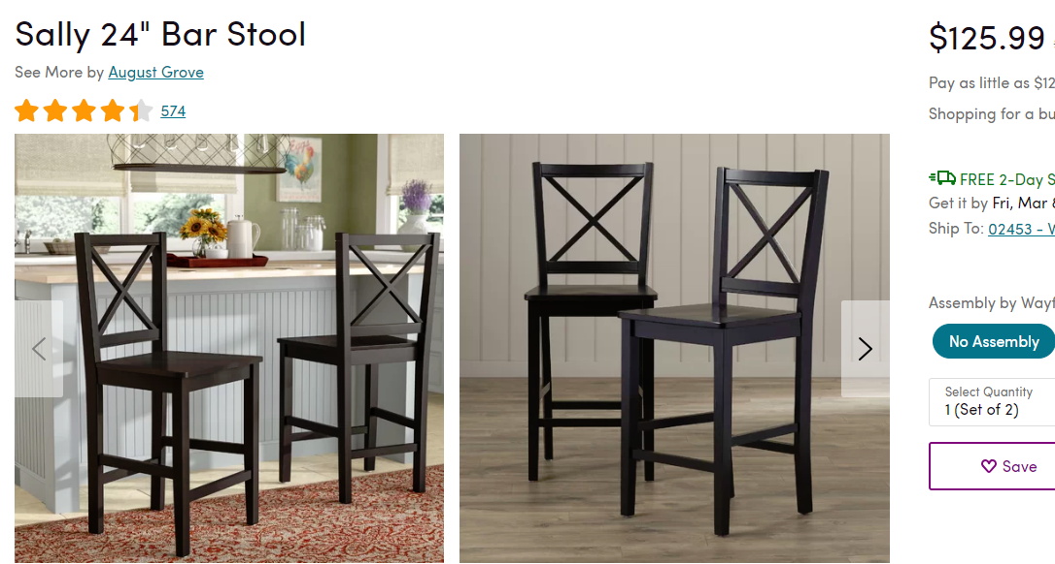
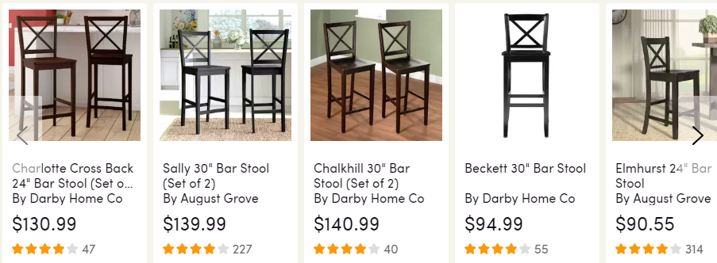
Understanding Customer Psychographics Trends that leads to Conversions
We finally have the psychographic data : How much time users who reacted to sale/banners spend surfing Wayfair and how many pages they visit) of buyers vs non-buyers.
Of the customers who reacted to the sale/banners and purchased, we didn't find a normal distribution that is skewed to the right. There seems to be a sweet spot (9 mins to 65 minutes and 10 to 70 pages views) in the buyer’s distribution. Outside this range, we find that if people engage with the platform beyond a certain number of minutes or beyond a certain number of pages, the users would end up not purchasing anything. We tried to find the reason by surveying a small sample of customers. We found that this could happen because users get jaded or overwhelmed with the number of options, and hence leave items in the cart without purchasing. This hypothesis needs to be validated by A/B testing on a bigger sample.

Slide 7
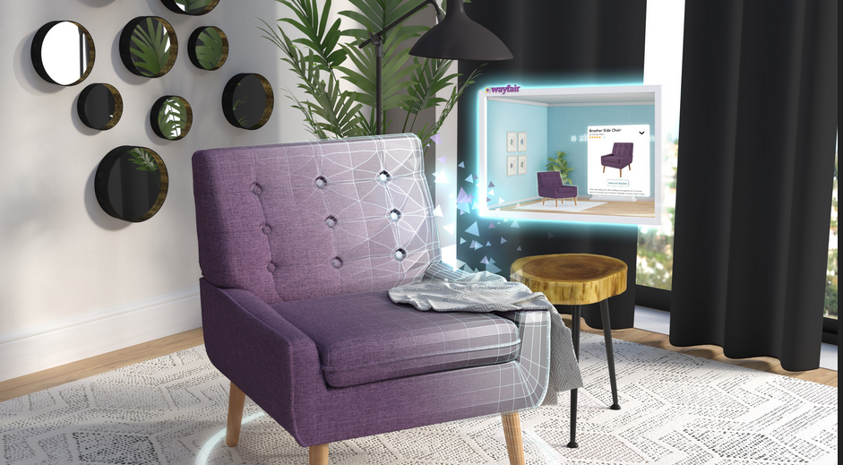
Wayfair is already using cutting edge technology like Augmented Reality and Artificial Intelligence. What if you could use Machine Learning to personalize User Experience?

Slide 8
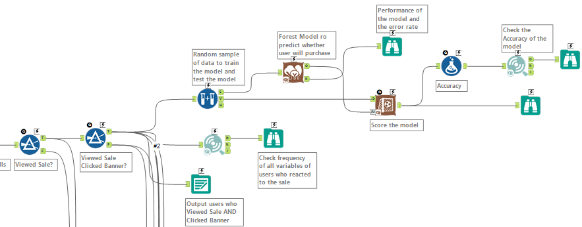

The Importance of Machine Learning to Personalize User Experience
Our team used the following machine learning models to predict whether a user would purchase given the set of inputs (demographic data, behavioral data, etc.)
Logistic Regression
Naïve Bayes
Decision Trees
Derivative of Decision Trees: Boost Model and Random Forest model
We used the Random Forest Model after comparing performances. The input of this model comprised of users who viewed sale AND clicked banners. Our model’s performance is as follows:
Model Performance
Accuracy | True Positives | 0.24%
 | True Negatives | 99.98%
Errors | False Positives | 0.02%
 | False Negatives | 99.76%
As you can see above, our model has a very high specificity rate: i.e. our model can very accurately (99.98%) predict when a customer, after reacting to sale, will not purchase. It performs very poorly if it has to predict whether a customer will convert (0.24%).
We can deploy this model in Wayfair’s server during the next sale season to gauge whether a user is about to abandon cart after reacting to sale.

Slide 9
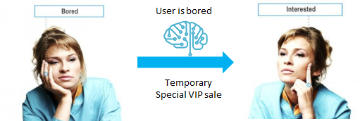
Deploy the predictive model to Personalize User Experience
As soon as our machine learning model identifies users who are about to abandon their cart, Wayfair can change their interaction with them:
Offer a special VIP sale that ends in a few hours.
Grant the jaded user a sneak peak into the new AR capability
Grant customer access to other specialized tools
Show relevant recommendation based on user’s demographics and search history
Pop-up chat with interior designer consultant

Slide 10

Feedback/Q&A

Slide 11


Slide 12
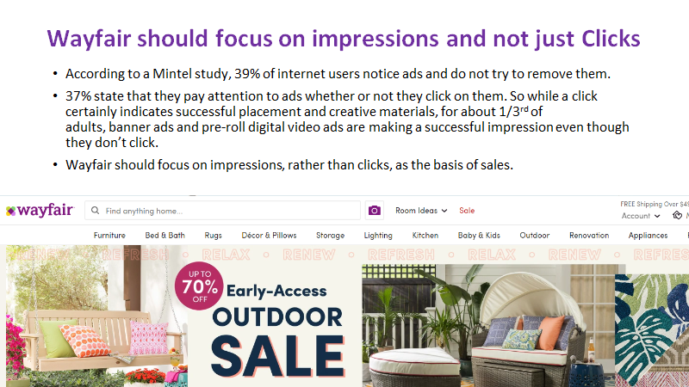

Slide 13
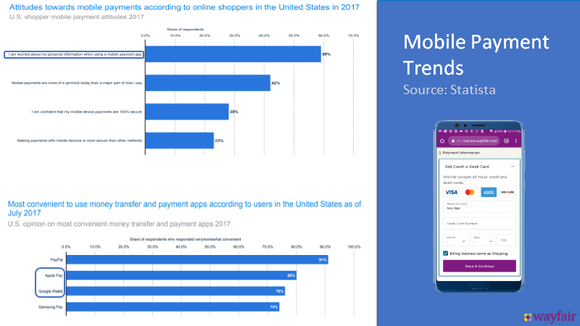

Slide 14
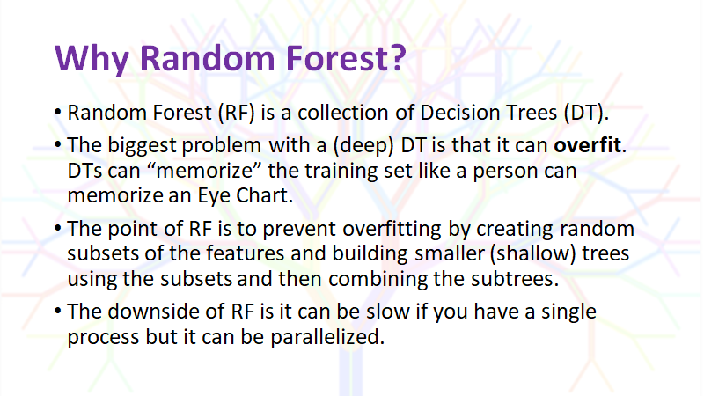

Slide 15
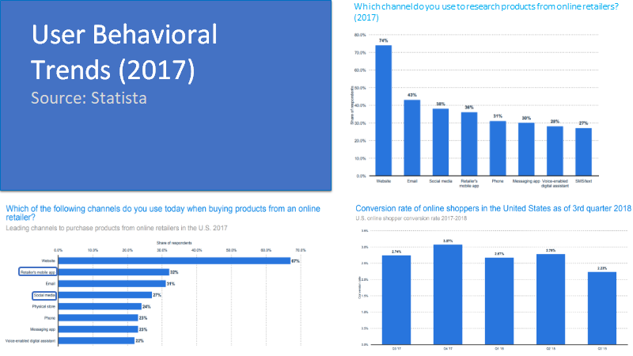

Slide 16
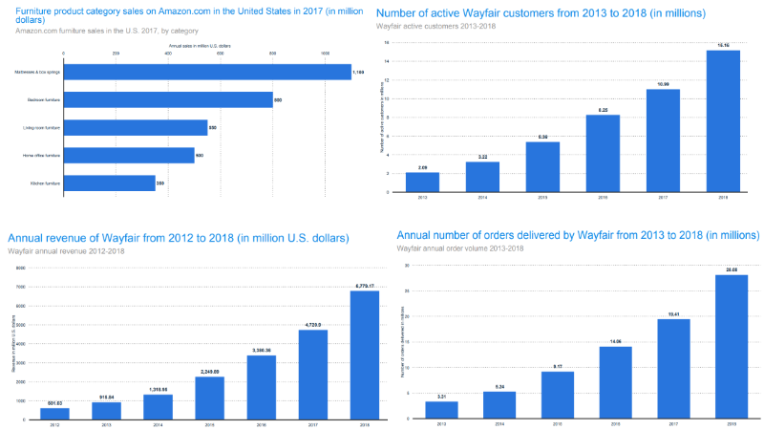

Slide 17
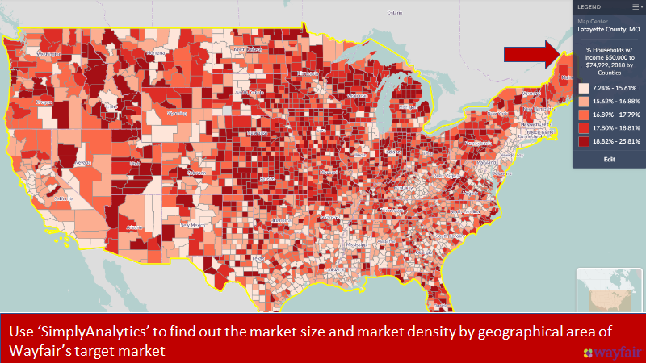

Slide 18


Slide 19
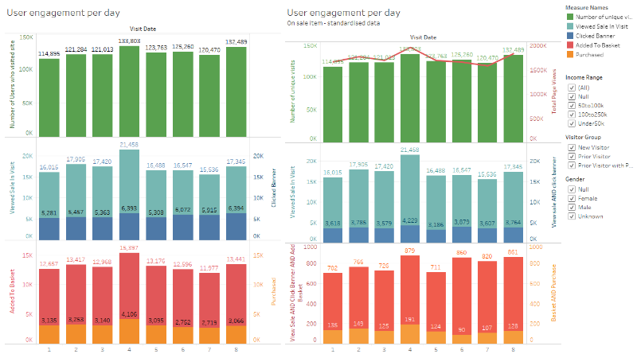

Slide 20
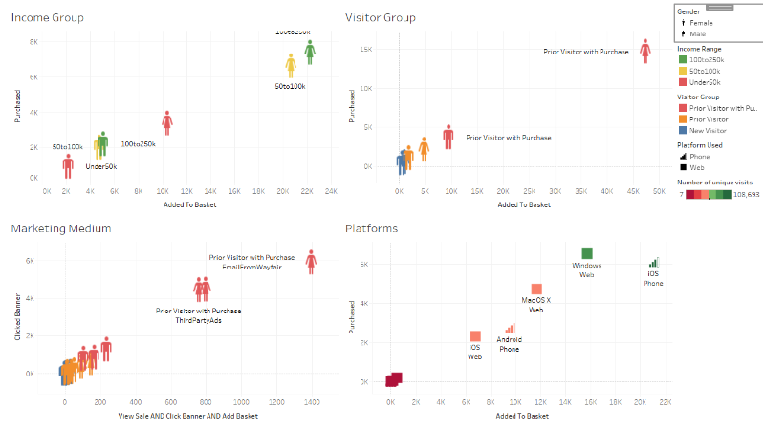

Slide 21
